Slide 1
ECE 337
NTLM Brute Force Hash Cracker
Group Members: Tom Yurak, Clayton Brandt, Darius Elliott, and Adit Ghosh

Slide 2
Design Overview
Input: An NTLM hash or multiple hashes.
Output: The corresponding “string” (can be alpha and numerical values) that was used to produce the hash that was inputted.
Usability: The purpose of this design on an ASIC device is speed, for the amount of calculations that are needed to be process. Which could be of use to Penetration testers and security researchers testing the strength of their systems.

Slide 3
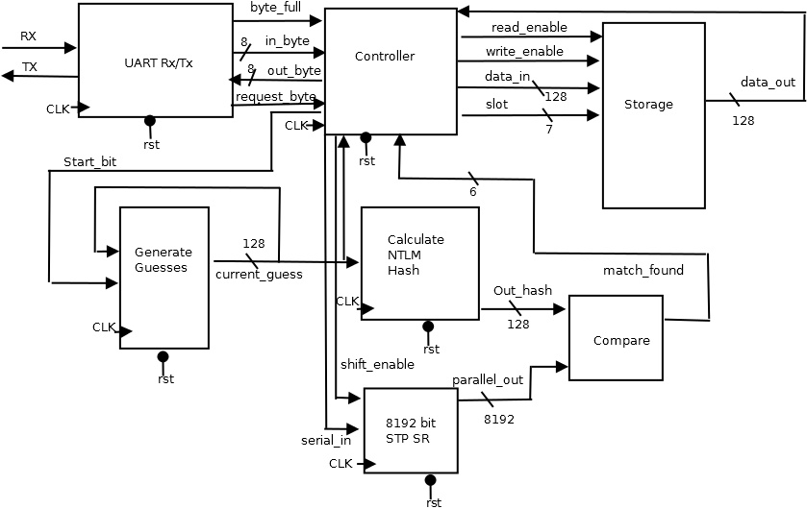
System Design & Design Architecture

Slide 4
System Design: Transmission
UART Transceiver
Originally it was decided to use an SPI Master to Slave interface, but it was later replaced with the UART Transceiver, in order to ease the external interfacing for example, using a USB to UART transmission.
Receiver: The UART Receiver is operating at 400 Mhz system clock with a data rate of 40 Mbps.
Transmitter: The UART Transmitter is operating at 100 Mhz system clock with a data rate of 10 Mbps.
Data: The data that is transmitted is 10 bit package including a start, stop bit and 8 bits of data, coming in either direction.

Slide 5
System Design: Hash Algorithm
An NTLM hash algorithm is an MD4 hash of a string converted to UTF-16 in little endian format. Since we’re assuming the input that generated the hashes is ASCII, a simple conversion is needed.

Slide 6
ASCII To UTF-16 Little Endian
A UTF-16 character is represented with two bytes, but the relevant ASCII characters are simply keep their values, but with a null byte appended in front. The ordering must also be changed to account for Little Endian, so the final result looks like this:
“abcd” -> “a\0b\0c\0d\0”

Slide 7
Padding
The hashing algorithm operates on binary strings of a length congruent to 448, modulo 512. Since our ASIC will work with ASCII strings of length up to 16, which is 256 bits of Utf-16, we will always pad (by appending zeros) to length 448.

Slide 8
The Last 64 bits
Any number that is congruent to 448, modulo 512 is 64 bits shy of a multiple of 512. The MD4 algorithm operates on binary strings in groups of 512 bits. Before we can start the hashing algorithm, we must append the length of our Unicode string in bits (as a 64 bit number) to the end of our string.

Slide 9
Starting the Hashing Process
Start by initializing four registers to the following values.
A = 01 23 45 67 B = 89 ab cd ef C = fe dc ba 98 D = 76 54 32 10
Let the function F(X,Y,Z) = X&Y | ~X&Z
Let [abcd k s] denote the operation: a = (a + F(b,c,d) + X[k]) <<< s, where + indicates addition and <<< indicates a circular shift, and X[k] is the string you are hashing, represented as an array of 32-bit words.
Then the first round of the algorithm is as follows
[ABCD 0 3] [DABC 1 7] [CDAB 2 11] [BCDA 3 19] [ABCD 4 3] [DABC 5 7] [CDAB 6 11] [BCDA 7 19] [ABCD 8 3] [DABC 9 7] [CDAB 10 11] [BCDA 11 19] [ABCD 12 3] [DABC 13 7] [CDAB 14 11] [BCDA 15 19]

Slide 10
Rounds 2 and 3
Round 2,
Let G(X,Y,Z) = X&Y | X&Z | Y&Z Let [abcd k s] represent a = (a + G(b,c,d) + X[k] + 5A827999) <<< s
[ABCD 0 3] [DABC 4 5] [CDAB 8 9] [BCDA 12 13] [ABCD 1 3] [DABC 5 5] [CDAB 9 9] [BCDA 13 13] [ABCD 2 3] [DABC 6 5] [CDAB 10 9] [BCDA 14 13] [ABCD 3 3] [DABC 7 5] [CDAB 11 9] [BCDA 15 13]
Round 3,
Let H(X,Y,Z) = X xor Y xor Z Let [abcd k s] represent a = (a + H(b,c,d) + X[k] + 6ED9EBA1) <<< s
[ABCD 0 3] [DABC 8 9] [CDAB 4 11] [BCDA 12 15] [ABCD 2 3] [DABC 10 9] [CDAB 6 11] [BCDA 14 15] [ABCD 1 3] [DABC 9 9] [CDAB 5 11] [BCDA 13 15] [ABCD 3 3] [DABC 11 9] [CDAB 7 11] [BCDA 15 15]

Slide 11
The Rest of The Algorithm
To finish, increment the registers A, B, C, and D by their initial values. The NTLM hash will be the 128 bit result of appending A, B, C, and D together.
Adapted from RFC1320

Slide 12
The Problem with a Purely Combinational Implementation
A purely combinational implementation of this algorithm would result in a very long critical path. Consider the first few operations of Round 1:
A += B&C | ~B&D + X[0]; A = (A << 3 ) | (A >> 29); D += A&B | ~A&C + X[1]; D = (D << 7 ) | (D >> 25); C += D&A | ~D&B + X[2]; C = (C << 11) | (C >> 21); B += C&D | ~C&A + X[3]; B = (B << 19) | (B >> 13);
Every line in this code is dependant on the line above it. The full algorithm would be 98 successive lines of such code!

Slide 13
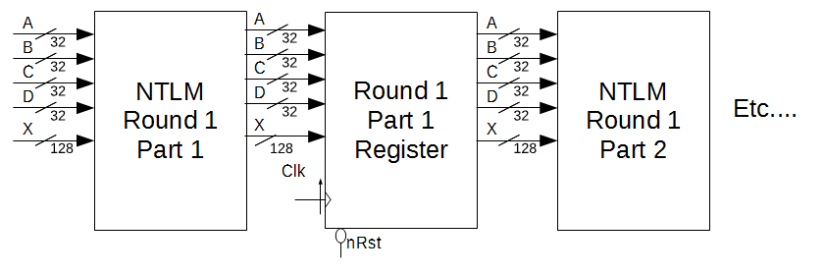
Solution: Pipelining
Our solution breaks the combinational logic up into small parts, feeding in a new string and turning out a new hash every clock cycle.

Slide 14
System Design: Compare & Store
Compare: It compares the current output hash to the hashes in the shift register.
Storage: The storage component uses SRAM on-chip. The SRAM reads and writes 128 bits of data according to read and write enable signals sent by the controller.

Slide 15
Success Criteria
1.Demonstrate by simulation of Verilog test benches that the complete design is able to successfully match a generated password to that of an inputted hash.
2. Demonstrate by simulation of Verilog test benches that the complete design is able to store multiple hashes inputted on a UART line.
3. Demonstrate by simulation of Verilog test benches that the complete design is able to output multiple matched passwords.
4. Demonstrate by simulation of Verilog test benches that the complete design is able to ignore invalid input and will not produce an output for the given input.
5. Demonstrate by simulation of Verilog test benches that the complete design is able to generate a valid NTLM hash.
6. Demonstrate by simulation of Verilog test benches that the design functions correctly for different inputted character sets.

Slide 16
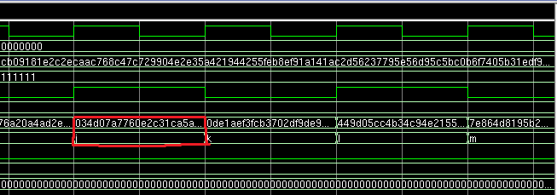
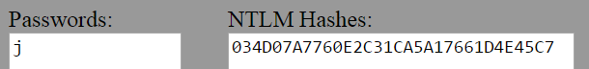
Test Results
Fulfills DSC 5

Slide 17
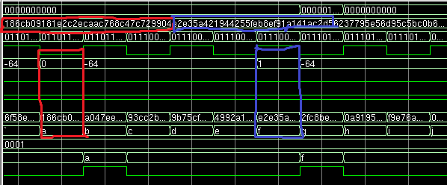
Test Results
Fulfills DSC 1,3

Slide 18
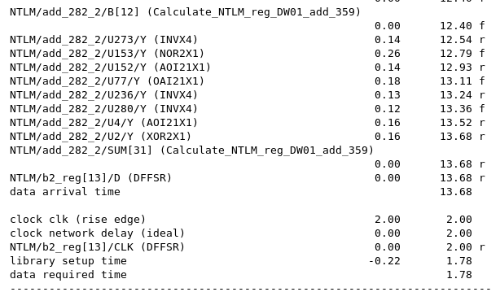
Timing Budget

Slide 19

Area Budget

Slide 20
Conclusions
Biggest Challenges?: The biggest challenges were developing the hash algorithm, and porting all of the different components to work with each other.
What we would do differently?: Plan more ahead and work more together so that we know what each person needs as plans change or develop.
Improvements?: To be able to select certain character sets in the design to find a hash for.
Notes:
Improvements: Allowing for a user to select custom character sets,

Slide 21
Questions?

Slide 22
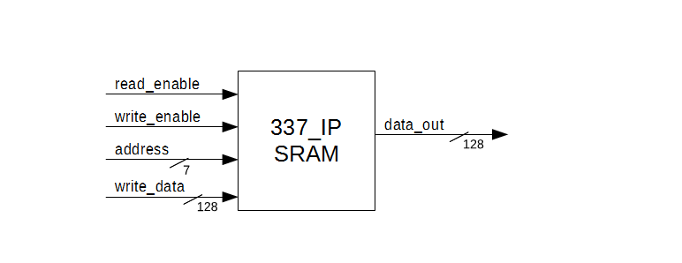
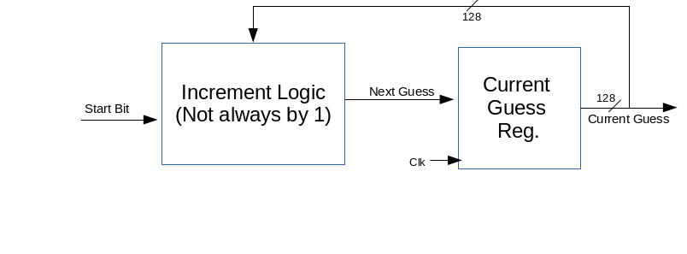
Backup Slides
Storage:
Generate
Guess:

Slide 23
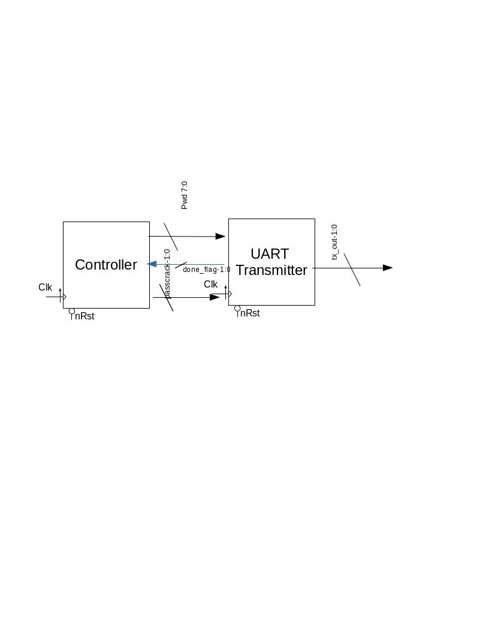
Backup Slides
Transmitter:

Slide 24
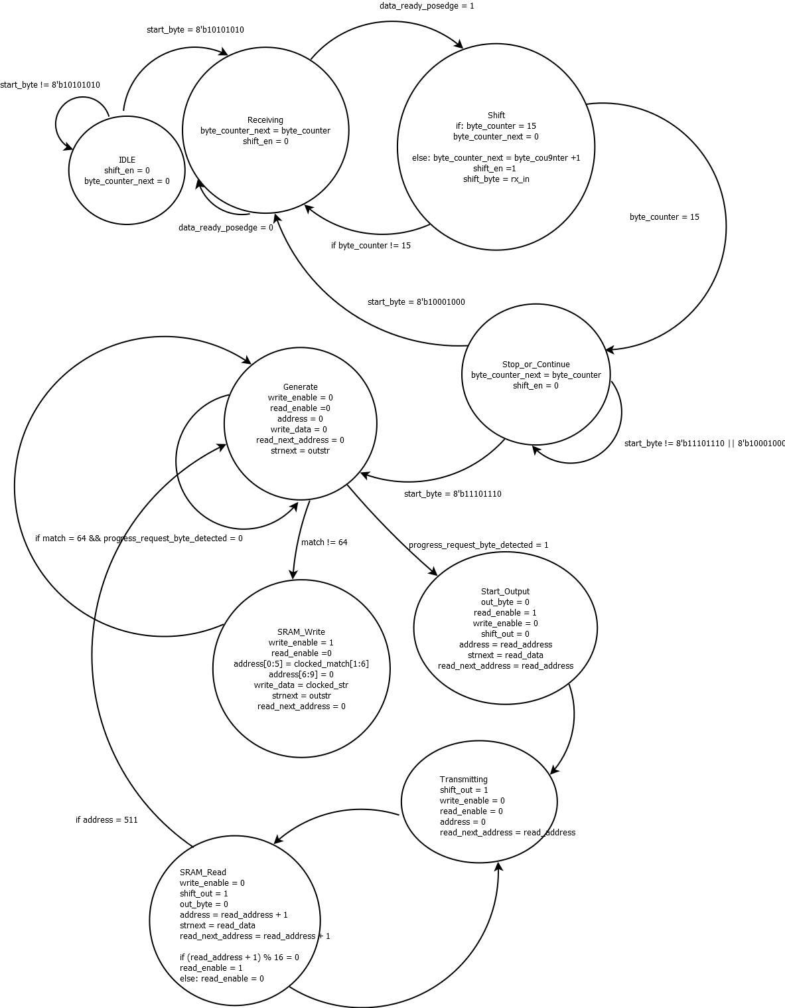
Backup Slides
Controller State Transition Diagram Pt. 1

Slide 25
Backup Slides
Controller State Transition Diagram Pt. 2

